Slide 1

Identify root components of website below

Slide 2

Root div
- Height: 100vh
content
nav
Flex: 0
header
Flex: 0
Flex: 1

Slide 3
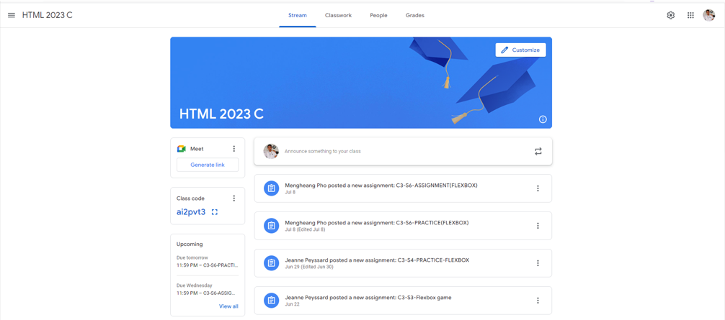
header
Main

Slide 4
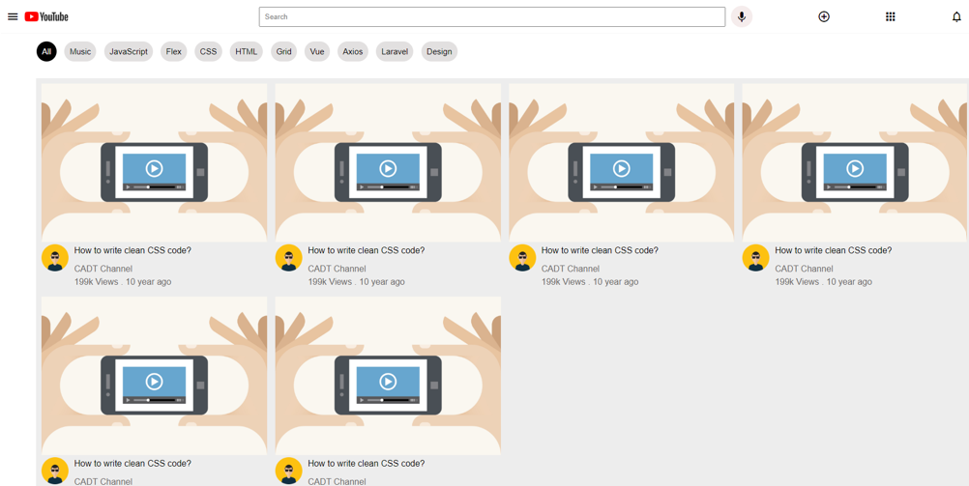
header
navigate
main

Slide 5

basic
standard
premium

